Slide 1
ShopWise
Get the best price available in just one search!

Slide 2
ShopWise is intended to help shoppers find the best prices and availability of their favorite products. Members are given quick and easy access to both Amazon product searches with just one click, so you can choose the best value for your money! Eventually, additional major shopping API’s will be added to give members more purchase options. Shoppers will sign up by entering an email address and choosing a password, and when logged in, they will be able to select any product category from the drop down menu, and shop.

Slide 3
Concept
The application is a Member Only shopping portal that pulls product data from Amazon’s API.
The motivation for developing the application is to give shoppers easy access to the best prices on the internet and an easy way to get their favorite products from one search. The technologies used include Node and Express server, mySQL, Sequelize, and Bootsnip for front end layout and design.

Slide 4
Process
Technologies used: Bootsnip, Bootstrap, Ebay API, Amazon API, Node Express, Sequelize, and MYSQL. Breakdown of tasks and roles:
Eleanor: API, Backend, Presentation
Mira: API, Backend, and Frontend
Aboudou: SQL, and Backend
Eric: Front End, CSS
Challenges: Delegation of tasks, workflow communication, and GITHUB!
Successes: We have a basic application and a platform for future collaborations.

Slide 5
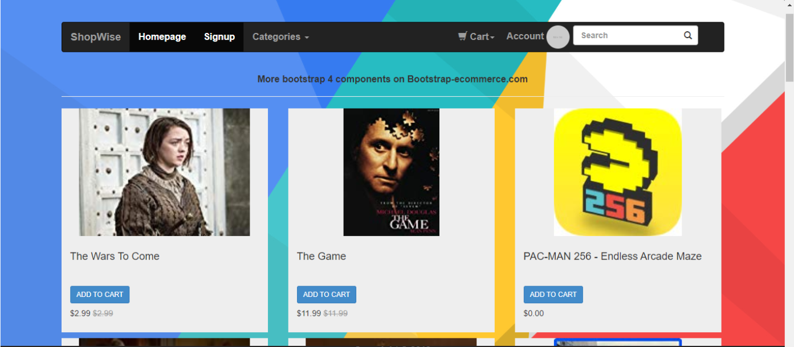
Demo

Slide 6
Directions for Future Development
Add Ebay API
Add more Shopping Categories
Add a section for Members Review
Refine the UI Design

Slide 7
Links
Github Repo:
https://github.com/EMaynard802/Project2
Deployed Application:
COMING SOON (Heroku link will be here.)

